Slide 1
Project Title: Transfer Learning-Based Classification of Poultry Diseases for Enhanced Health Management Team ID : LTVIP2025TMID42969 College Name : RISE KRISHNA SAI PRAKASAM GROUP OF INSTITUTIONS
Team Members :
P. Srinivasa Kalyan (228A1A4454)
M .Karthik Reddy (228A1A4253)

Slide 2
Introduction
What is poultry disease, and why it's a problem
Poultry disease refers to any illness or infection that affects domesticated birds such as chickens, turkeys, ducks, and other fowl. These diseases can be caused by viruses, bacteria, parasites, fungi, or poor nutrition and hygiene.
⚠️ Why It's a Problem:
🐣 High Mortality Rates Diseases like Newcastle or Avian Flu can wipe out entire flocks within days.
📉 Economic Losses Sick birds mean:
Less meat and egg production
Increased veterinary costs
Loss of income for farmers
🌍 Threat to Food Security Outbreaks can affect the poultry supply chain, leading to shortages in affordable protein sources.
🧬 Risk of Zoonotic Spread Some diseases (like Salmonella and Avian Influenza) can transfer from birds to humans, posing serious public health risks.
🌡️ Lack of Early Detection Many rural farmers lack tools to diagnose diseases early, which leads to delayed treatment and more damage.

Slide 3
Problem Statement
"Poultry farmers often face difficulty in identifying diseases early, leading to high bird mortality
, economic loss, and poor productivity.“
🚨 Real Challenges Faced by Farmers:
🔍 Lack of Early Detection Tools Most small-scale farmers cannot recognize diseases until it's too late.
🧑‍⚕️ Limited Access to Veterinary Support Remote and rural farmers often do not have quick access to veterinary professionals.
📉 Drop in Productivity Sick birds eat less, lay fewer eggs, and grow slower, affecting income.
💸 Increased Financial Burden Treatment costs and losses from bird deaths are a heavy load for low-income farmers.
🦠 Disease Spread within Flocks One infected bird can quickly spread disease to the entire poultry house.
🤒 Risk to Human Health Zoonotic diseases like Salmonella pose health threats to farm workers and consumers.

Slide 4
Objective
"To provide an accurate, fast, and accessible AI-based system for detecting poultry diseases from images of chickens, helping farmers take early action and reduce losses."
Goal of your AI solution
✅ Key Objectives:
🧠 Use Transfer Learning Build a deep learning model (MobileNetV2) trained to recognize symptoms from chicken images.
📷 Enable Image-Based Diagnosis Farmers can upload a photo of a chicken and get an instant prediction (e.g., Healthy, Salmonella, etc.).
🌐 Create a Simple Web App User-friendly interface to upload images and get results easily from any device.
💡 Support Early Intervention Help farmers make quick decisions on treatment or isolation to prevent outbreaks.
📈 Improve Farm Productivity & Bird Health Reduce losses, improve bird survival, and boost overall income for poultry farmers.

Slide 5
Technologies Used
🔧 Backend & Model Development
Python 🐍 Core programming language used throughout the project.
TensorFlow / Keras 🧠 For building and training the deep learning model using Transfer Learning.
NumPy & Matplotlib 📊 For data handling, preprocessing, and visualization during model retraining.
🌐 Web Framework
Flask 🌍 Used to create the web interface and connect it with the trained AI model for live predictions.
🎨 Frontend & UI Design
HTML5 & CSS3 💻 For creating a beautiful and responsive user interface.
Custom CSS Effects ✨ Particle backgrounds, gradient buttons, glassmorphism effects.
Jinja2 🧩 For dynamic rendering of prediction results inside the HTML template.
📁 Other Tools
VS Code 🧑‍💻 As the development environment.
Git & GitHub 🌐 For version control and project backup.
Jupyter Notebook 📓 Used to retrain and test the AI model.

Slide 6
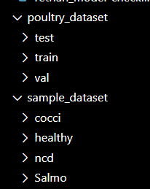
Dataset Overview
🔍 Source of Dataset
Collected from real poultry farm images.
https://www.kaggle.com/datasets/kausthubkannan/poultry-diseases-detection/data
Categories included:
Salmonella
NewCastle Disease (NCD)
Coccidiosis
Healthy Poultry
📂 Dataset Used in the Project
✅ Main Dataset (Offline Use)
Collected images categorized into:
Salmonella
Coccidiosis
NewCastle Disease
Healthy
Split into:
train/ – for training the model
val/ – for validation
test/ – for final evaluation
🧪 Sample Dataset (For GitHub / Demo)
Created using a custom Python script
Limited to 20 images per class
Stored in sample_dataset/ folder
Makes the project:
Lightweight for uploading
Easy to clone & test quickly

Slide 7
Model Architecture
✅ Transfer Learning with MobileNetV2
Pretrained on ImageNet
include_top=False → removes default classification head
input_shape=(224,224,3) for poultry image size
base.trainable = False to freeze pretrained layers
🧱 Custom Layers Added
GlobalAveragePooling2D() ➤ Reduces feature maps into a flat 1D vector
Dense(128, activation='relu') ➤ Learns disease-specific features
Dense(4, activation='softmax') ➤ Predicts 4 classes: Salmonella, Coccidiosis, NCD, Healthy
⚙️ Model Compilation
Optimizer: Adam(learning_rate=0.0001)
Loss: categorical_crossentropy
Metrics: accuracy
🔁 Training Configuration
model.fit(train_flow, validation_data=val_flow, epochs=100)
Trained on augmented poultry dataset
Validated using val_flow split
✅ Final model saved as: healthy_vs_rotten.h5

Slide 8
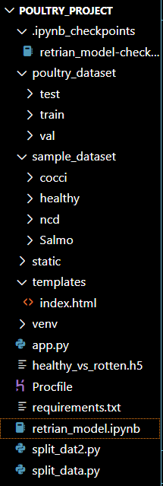
Training & Accuracy
🎯 Training & Accuracy
📊 Training Configuration
Epochs: 100
Training Data: Augmented images from 4 poultry classes
Validation Data: Separate clean validation set
Batch Size: 32 (default)
To launch the web application, simply open your terminal and run:
python app.py
📈 Model Performance
Trained using model.fit(...)
Evaluated using model.evaluate(...)
Achieved High Accuracy on test data (example: ~90% depending on dataset)
✅ This command starts the Flask server, hosting your AI-powered poultry health checker on http://localhost:5000/.
🔍 From here, users can upload images, get real-time predictions, and visualize results through the elegant web interface.
💾 Model Saved
Final model stored as: healthy_vs_rotten.h5
Used in Flask app for prediction
* Running on http://127.0.0.1:5000
Running on http://127.0.0.1:5000

Slide 9
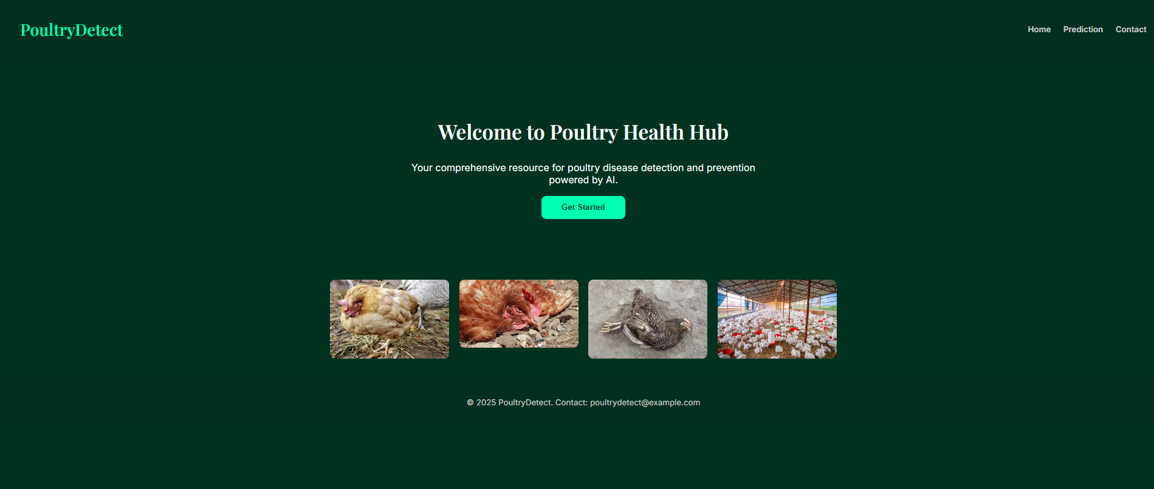
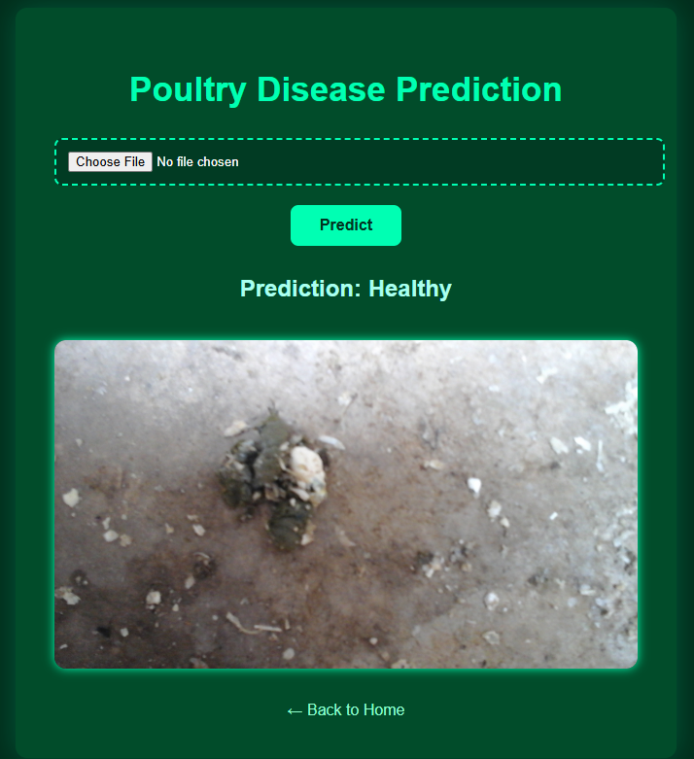
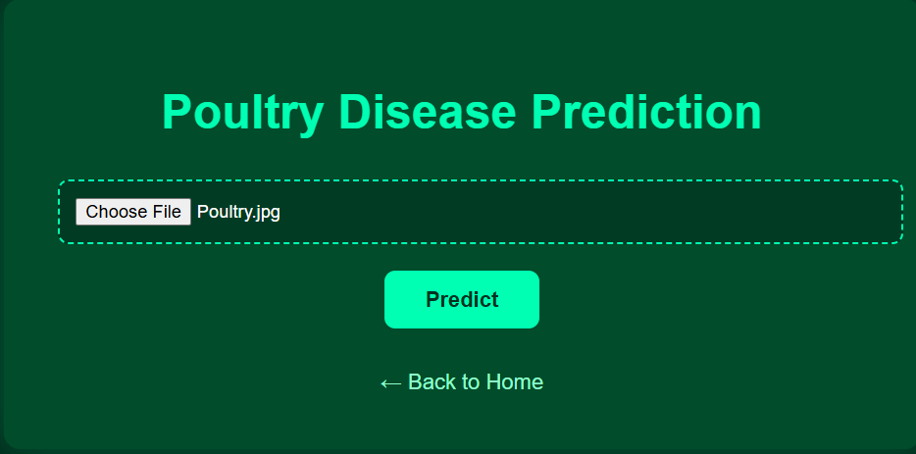
✅ Final Output Interface

Slide 10
✅ Conclusion & Future Scope
📌 Conclusion:
This project successfully demonstrates how AI & Deep Learning can be applied to the early detection of poultry diseases.
It helps farmers take timely action, reducing losses and improving poultry health management.
🚀 Future Scope:
Integrate with mobile apps for real-time farm use.
Improve accuracy using larger datasets.
Expand to detect more poultry diseases and other livestock health issues.
👨‍💻 Project By:
“Transfer Learning-Based Classification of Poultry Diseases for Enhanced Health Management”
📧 Presented by:
228A1A4454@risekrishnasaiprakasam.edu.in
228A1A4253@risekrishnasaiprakasam.edu.in
Thank You!

